Slide 1

Unit 2-Logic Families
Notes:
‹#›

Slide 2
Source: These slides contains copyrighted materials from – Digital Systems: Principles and Applications, 11/e
Ronald J. Tocci, Neal S. Widmer, Gregory L. Moss
Digital Systems: Principles and Applications, 11/e
Ronald J. Tocci, Neal S. Widmer, Gregory L. Moss

Slide 3
Chapter 8
Digital IC technology has advanced rapidly from integrations which can 1 million or more gates.
ICs pack more circuitry in a small package, so overall size of almost any system is reduced.
Cost is reduced because of the economies of mass-producing large volumes of similar devices.
ICs have made digital systems more reliable by reducing the number of external interconnections from one device to another.
Protected from poor soldering, breaks or shorts in connecting paths on a circuit board, and other physical problems.
Digital Systems: Principles and Applications, 11/e
Ronald J. Tocci, Neal S. Widmer, Gregory L. Moss

Slide 4
Chapter 8
ICs cannot handle very large currents or voltage.
Heat generated in such small spaces would cause temperatures to rise beyond acceptable limits.
For higher power levels, an interfacing circuit will be needed—typically of components or special power ICs.
ICs can’t easily implement certain devices such as inductors, transformers, and large capacitors.
Principally used to perform low-power circuit operations—commonly called information processing.
Digital Systems: Principles and Applications, 11/e
Ronald J. Tocci, Neal S. Widmer, Gregory L. Moss

Slide 5
Chapter 8
Various logic families differ in major components in their circuitry.
TTL and ECL use bipolar transistors as their major circuit element.
PMOS, NMOS, and CMOS use unipolar MOSFET transistors.
Digital Systems: Principles and Applications, 11/e
Ronald J. Tocci, Neal S. Widmer, Gregory L. Moss

Slide 6
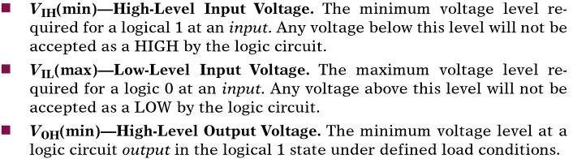
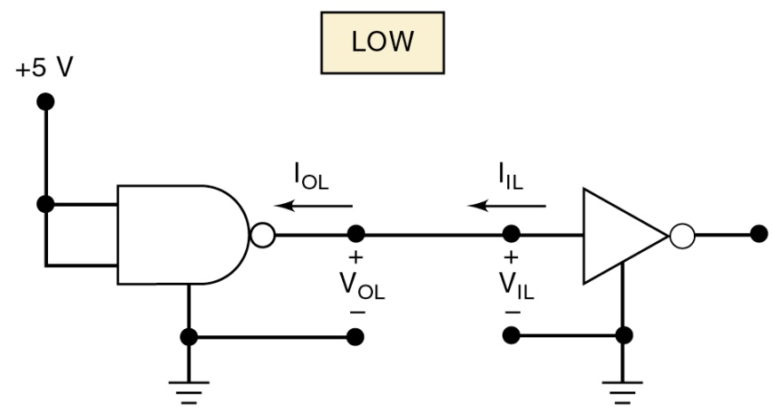
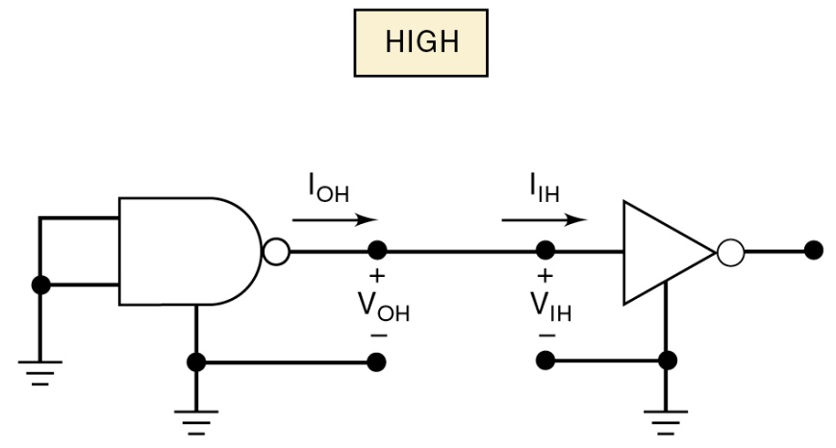
8-1 Digital IC Terminology
IC nomenclature & terminology is fairly standardized.
Digital Systems: Principles and Applications, 11/e
Ronald J. Tocci, Neal S. Widmer, Gregory L. Moss

Slide 7
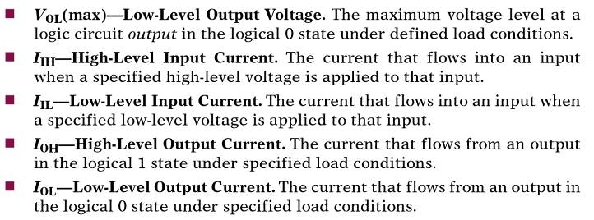
8-1 Digital IC Terminology
IC nomenclature & terminology is fairly standardized.
Digital Systems: Principles and Applications, 11/e
Ronald J. Tocci, Neal S. Widmer, Gregory L. Moss

Slide 8
8-1 Digital IC Terminology – Fan Out
A logic-circuit output is generally required to drive several logic inputs.
Sometimes all ICs are from the same logic family.
But many systems have a mix of various logic families.
The fan-out—loading factor—is the maximum number of logic inputs an output can drive reliably.
Digital Systems: Principles and Applications, 11/e
Ronald J. Tocci, Neal S. Widmer, Gregory L. Moss

Slide 9
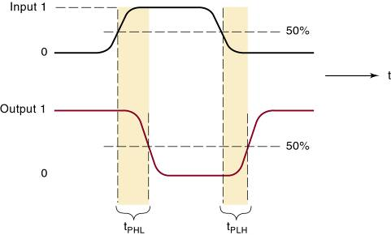
8-1 Digital IC Terminology – Propogation Delay
A logic signal always experiences a delay going through a circuit.
The two propagation delay times are defined as:
Propagation
delays.
Digital Systems: Principles and Applications, 11/e
Ronald J. Tocci, Neal S. Widmer, Gregory L. Moss

Slide 10
8-1 Digital IC Terminology – Power Requirements
Every IC requires a certain amount of electrical power to operate.
Supplied by one or more power-supply voltages connected at V_{CC} (TTL) or V_{DD} (MOS devices).
For many ICs, current drawn from the supply varies depending on logic states of the circuits on the chip.
Digital Systems: Principles and Applications, 11/e
Ronald J. Tocci, Neal S. Widmer, Gregory L. Moss

Slide 11
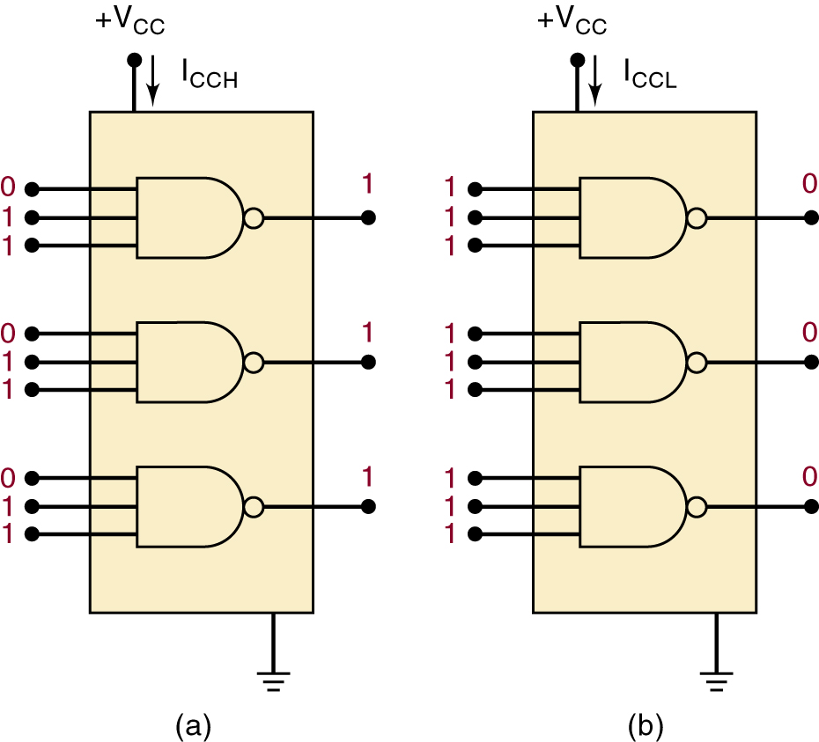
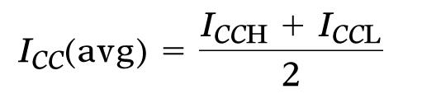
8-1 Digital IC Terminology – Power Requirements
The amount of power an IC requires is determined by the current, I_{CC} (or I_{DD}) it draws from the supply.
Actual power is the product I_{CC} x V_{CC} (I_{DD} x V_{DD} ).
In some logic circuits, average current is computed based on the assumption that gate outputs are LOW half the time and HIGH half the time.
Digital Systems: Principles and Applications, 11/e
Ronald J. Tocci, Neal S. Widmer, Gregory L. Moss

Slide 12

8-1 Digital IC Terminology – Power Requirements
The amount of power an IC requires is determined by the current, I_{CC} (or I_{DD}) it draws from the supply.
Actual power is the product I_{CC} x V_{CC} (I_{DD} x V_{DD} ).
can be rewritten to calculate average power dissipated:
Digital Systems: Principles and Applications, 11/e
Ronald J. Tocci, Neal S. Widmer, Gregory L. Moss

Slide 13
8-1 Digital IC Terminology – Noise
Stray electric/magnetic fields can induce voltages on the connecting wires between logic circuits
Called noise, these unwanted, spurious signals can sometimes cause unpredictable operation.
Digital Systems: Principles and Applications, 11/e
Ronald J. Tocci, Neal S. Widmer, Gregory L. Moss

Slide 14


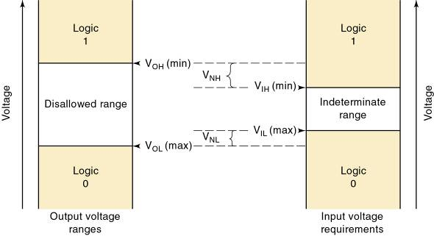
8-1 Digital IC Terminology – Noise
Noise immunity refers to the circuit’s ability to tolerate noise without changes in output voltage.
A quantitative measure is called noise margin.
High-state noise margin:
Low-state noise margin:
Digital Systems: Principles and Applications, 11/e
Ronald J. Tocci, Neal S. Widmer, Gregory L. Moss

Slide 15
8-1 Digital IC Terminology – Invalid Voltage
For proper operation, logic circuit input voltage levels must be kept out of the indeterminate range.
Lower than V_{IL}(max) or higher than V_{IH} (min).
Invalid voltage will produce unpredictable output.
It is important to know valid voltage ranges for the logic family being used so invalid conditions can be recognized when testing or troubleshooting.
Logic families can be described by how current flows between the output of one logic circuit and the input of another.
Digital Systems: Principles and Applications, 11/e
Ronald J. Tocci, Neal S. Widmer, Gregory L. Moss

Slide 16
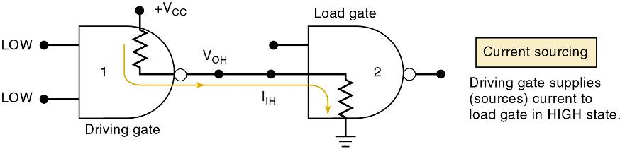
8-1 Digital IC Terminology – Current Sourcing/Sinking
Current-sourcing action.
When the output of gate 1 is HIGH, it supplies current I_{IH} to the input of gate 2.
Which acts essentially as a resistance to ground.
The output of gate 1 is acting as a source of current for the gate 2 input.
Digital Systems: Principles and Applications, 11/e
Ronald J. Tocci, Neal S. Widmer, Gregory L. Moss

Slide 17
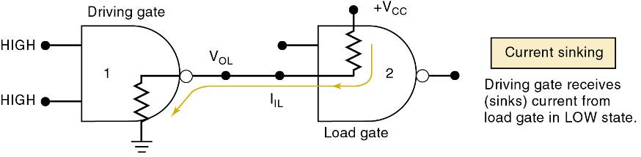
8-1 Digital IC Terminology – Current Sourcing/Sinking
Current-sinking action.
Input circuitry of gate 2 is represented as a resistance tied to +V_{CC} —the positive terminal of a power supply.
When gate 1 output goes LOW, current will flow from the input circuit of gate 2 back through the output resistance of gate 1, to ground.
Circuit output that drives the input of gate 2 must be able to sink a current, I_{IL} , coming from that input.
Digital Systems: Principles and Applications, 11/e
Ronald J. Tocci, Neal S. Widmer, Gregory L. Moss

Slide 18
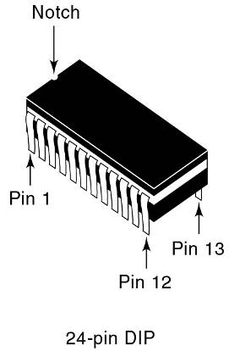
8-1 Digital IC Terminology – IC Packages
There are many IC packages, differing in physical size, environmental & power consumption conditions, and circuit board mounting
The DIP (dual-in-line package) has pins (leads) down the two long sides of the rectangular package.
The notch on one end, is used to locate pin 1.
Some DIPs use a small dot to locate pin 1.
Digital Systems: Principles and Applications, 11/e
Ronald J. Tocci, Neal S. Widmer, Gregory L. Moss

Slide 19
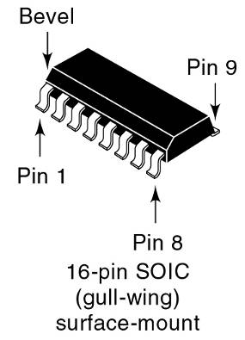
8-1 Digital IC Terminology – IC Packages
Current manufacturing methods use surface-mount technology (SMT), which places an IC onto conductive pads on the surface of the board.
Held in place by a solder paste, and the entire board is heated to create a soldered connection.
Precision machine placement allows for very tight lead spacing.
Leads are bent out from the plastic case, providing adequate surface area for the solder joint.
Digital Systems: Principles and Applications, 11/e
Ronald J. Tocci, Neal S. Widmer, Gregory L. Moss

Slide 20
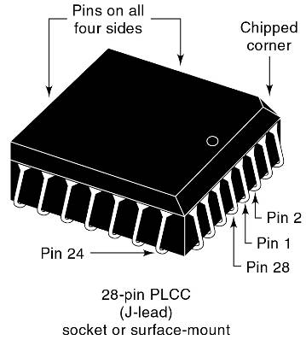
8-1 Digital IC Terminology – IC Packages
Need for more connections to a complex IC has resulted in another very popular package with pins on all four sides of the chip.
The PLCC has J-shaped leads that curl under the IC.
These devices can be surface-mounted to a circuit board—but can also be placed in a special socket.
Commonly used for components likely to need to be replaced for repair or upgrade.
Digital Systems: Principles and Applications, 11/e
Ronald J. Tocci, Neal S. Widmer, Gregory L. Moss

Slide 21
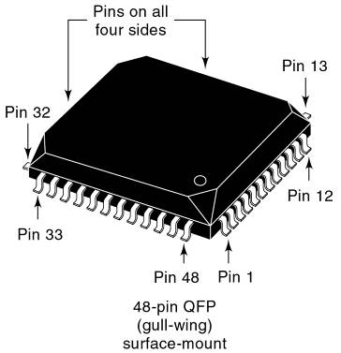
8-1 Digital IC Terminology – IC Packages
Need for more connections to a complex IC has resulted in another very popular package with pins on all four sides of the chip.
QFP and TQFP packages have pins on all four sides in a gull-wing surface- mount package.
Digital Systems: Principles and Applications, 11/e
Ronald J. Tocci, Neal S. Widmer, Gregory L. Moss

Slide 22
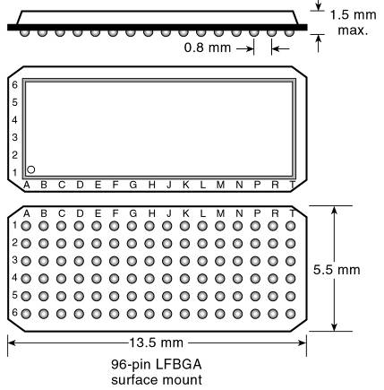
8-1 Digital IC Terminology – IC Packages
The ball grid array (BGA) shown in is a surface-mount package that offers even more density.
The pin grid array (PGA) is a similar package, use when components must be in a socket to allow easy removal.
The PGA has a long pin instead of a contact ball (BGA) at each position in the grid.
Digital Systems: Principles and Applications, 11/e
Ronald J. Tocci, Neal S. Widmer, Gregory L. Moss

Slide 23
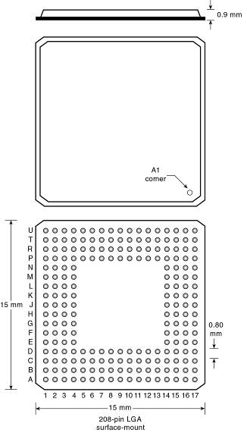
8-1 Digital IC Terminology – IC Packages
The land grid array (LGA) package is essentially a BGA package without the solder balls attached.
Digital Systems: Principles and Applications, 11/e
Ronald J. Tocci, Neal S. Widmer, Gregory L. Moss

Slide 24
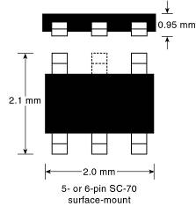
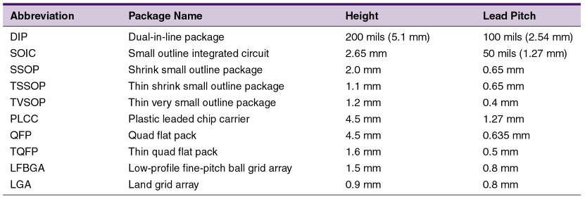
8-1 Digital IC Terminology – IC Packages
Logic gates are available in individual surface-mount packages containing one, two, or three gates, and as few as five or six pins (power, ground, two to three inputs, and an output)
Digital Systems: Principles and Applications, 11/e
Ronald J. Tocci, Neal S. Widmer, Gregory L. Moss

Slide 25
8-2 The TTL Logic Family
Most TTL circuits have a similar structure
NAND and AND gates use multiple-emitter transistor or multiple diode junction inputs.
NOR and OR gates use separate input transistors.
The input will be the cathode of a P-N junction
A HIGH input will turn off the junction.
Only a leakage current is generated.
A LOW input turns on the junction.
Relatively large current is generated.
Most TTL circuits have some type of totem-pole output configuration.
Digital Systems: Principles and Applications, 11/e
Ronald J. Tocci, Neal S. Widmer, Gregory L. Moss

Slide 26
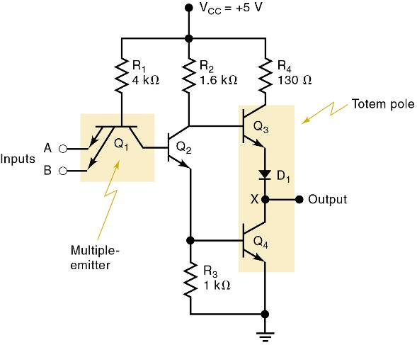
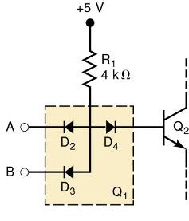
8-2 The TTL Logic Family
The basic TTL logic circuit is the NAND gate.
Diode equivalent for Q₁ .
Basic TTL NAND gate.
Digital Systems: Principles and Applications, 11/e
Ronald J. Tocci, Neal S. Widmer, Gregory L. Moss

Slide 27
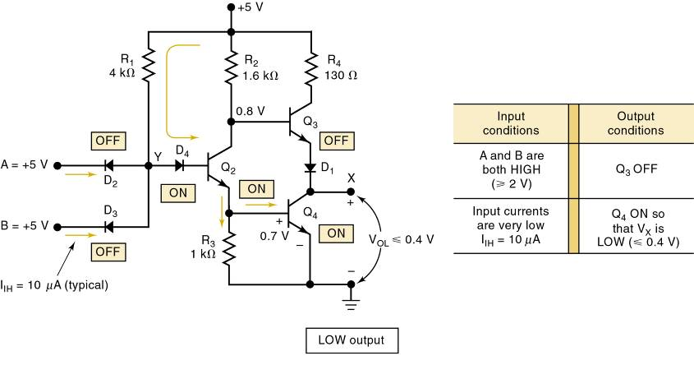
8-2 The TTL Logic Family
TTL NAND gate LOW output
Digital Systems: Principles and Applications, 11/e
Ronald J. Tocci, Neal S. Widmer, Gregory L. Moss

Slide 28
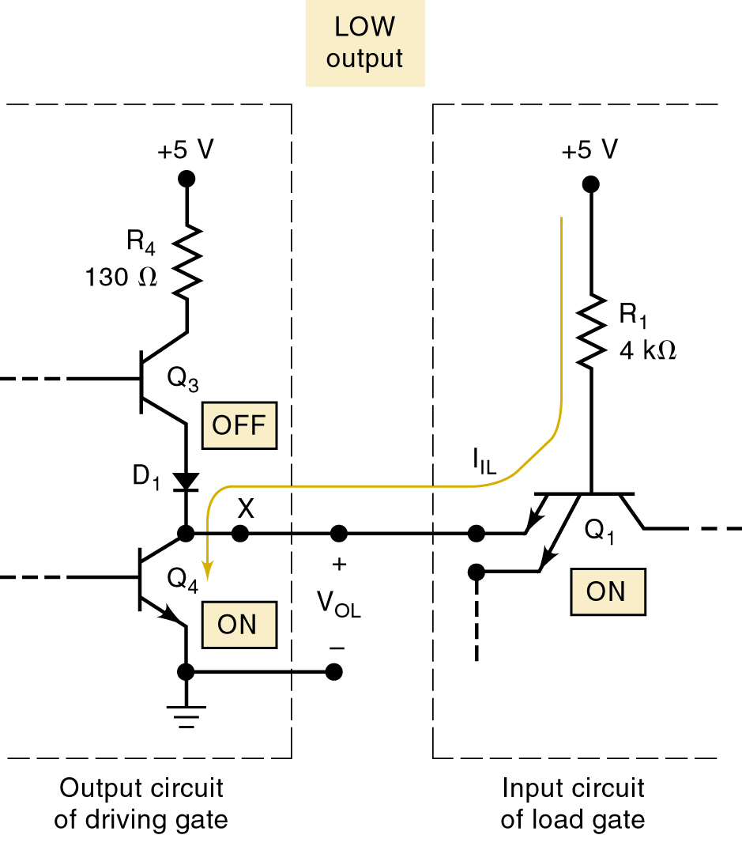
8-2 The TTL Logic Family
A TTL output acts as a current sink in the LOW state because it receives current from the input of the gate that it is driving.
Transistor Q₄ of the driving gate is on and essentially “shorts” point X to ground.
LOW voltage at X forward-biases the emitter–base junction of Q₁ & current flows back through Q₄.
Digital Systems: Principles and Applications, 11/e
Ronald J. Tocci, Neal S. Widmer, Gregory L. Moss

Slide 29
8-2 The TTL Logic Family
A TTL output acts as a current sink in the LOW state because it receives current from the input of the gate that it is driving.
Q₄ is performing a current-sinking action—deriving its current from the input current (I_{IL}) of the load gate.
Q₄ is often called the current-sinking transistor or pull-down transistor because it brings the output voltage down to its LOW state.
Digital Systems: Principles and Applications, 11/e
Ronald J. Tocci, Neal S. Widmer, Gregory L. Moss

Slide 30
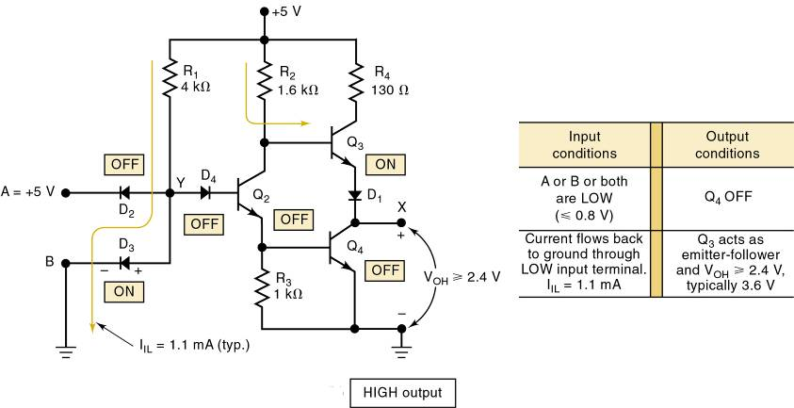
8-2 The TTL Logic Family
TTL NAND gate HIGH output
Digital Systems: Principles and Applications, 11/e
Ronald J. Tocci, Neal S. Widmer, Gregory L. Moss

Slide 31
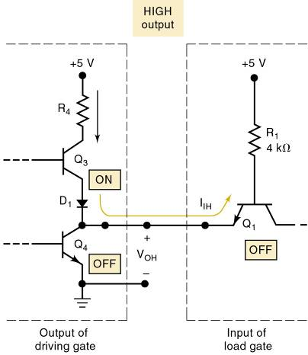
8-2 The TTL Logic Family
A TTL output acts as a current source in the HIGH state—a small reverse-bias leakage current.
Transistor Q₃ is supplying the input current (I_{IH}) required by Q₁ of the load gate.
Q₃ is often called the current-sourcing or pull-up transistor. In more modern TTL series, the pull-up circuit is made up of two transistors.
Digital Systems: Principles and Applications, 11/e
Ronald J. Tocci, Neal S. Widmer, Gregory L. Moss

Slide 32
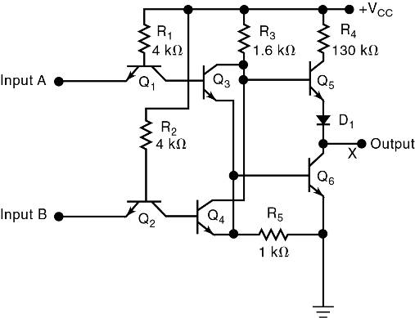
8-2 The TTL Logic Family
Internal circuit for a TTL NOR gate.
The NOR circuit does not use a multiple-emitter transistor. Each input is applied to the emitter of a separate transistor.
The NOR circuit uses the same totem-pole arrangement as the NAND circuit on the output side
Digital Systems: Principles and Applications, 11/e
Ronald J. Tocci, Neal S. Widmer, Gregory L. Moss

Slide 33
8-3 TTL Data Sheets
The first line of TTL ICs was the 54/74 series from Texas Instruments—introduced in 1964.
Manufacturers use the same numbering system.
Prefix indicates manufacturer.
SN – Texas Instruments.
DM – National Semiconductor.
S – Signetics.
DM7402, SN7402, S7402 perform the same function.
Data sheets contain electrical characteristics, switching characteristics, and recommended operating conditions.
Digital Systems: Principles and Applications, 11/e
Ronald J. Tocci, Neal S. Widmer, Gregory L. Moss

Slide 34
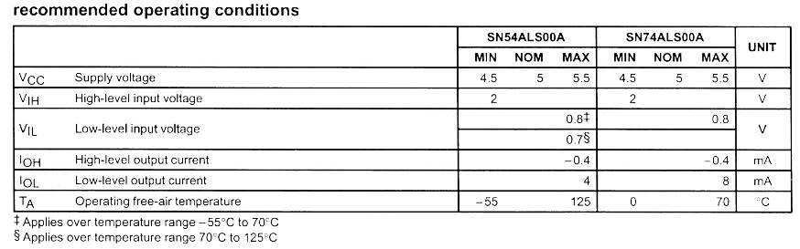
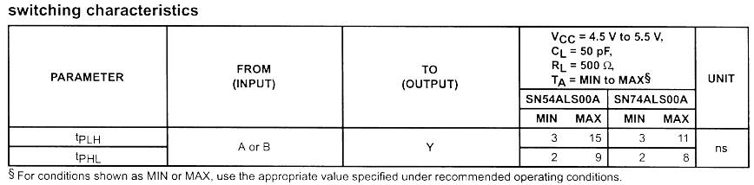
8-3 TTL Data Sheets
Data sheet for the 74ALS00 NAND gate IC
Digital Systems: Principles and Applications, 11/e
Ronald J. Tocci, Neal S. Widmer, Gregory L. Moss

Slide 35
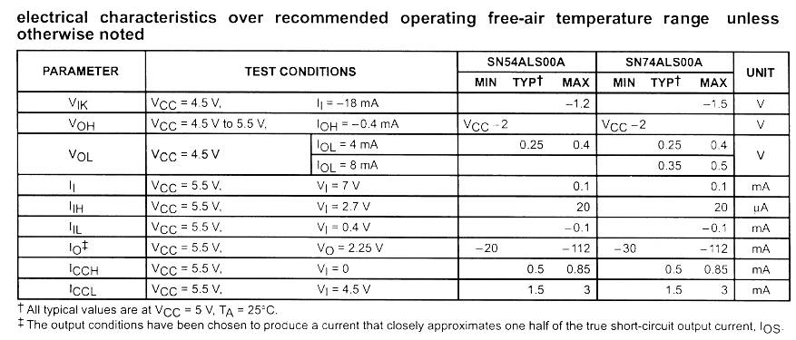
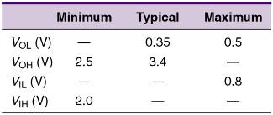
8-3 TTL Data Sheets
Data sheet for the 74ALS00 NAND gate IC
74ALS series
voltage levels.
Digital Systems: Principles and Applications, 11/e
Ronald J. Tocci, Neal S. Widmer, Gregory L. Moss

Slide 36
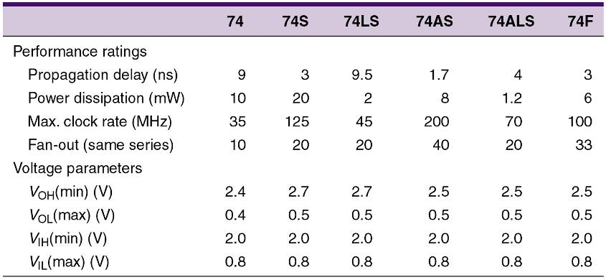
8-4 TTL Series Characteristics
Typical TTL series characteristics.
Digital Systems: Principles and Applications, 11/e
Ronald J. Tocci, Neal S. Widmer, Gregory L. Moss

Slide 37
8-5 TTL Loading and Fan-Out
Fan-out refers to the load drive capability of an IC output
A TTL output has a limit on how much current it can sink in the LOW state, or source in the HIGH state.
Exceeding these currents will result in output voltage levels outside specified ranges.
Determining fan out
Add the I_{IH} for all inputs connected to an output.
Sum must be less than the output I_{OH} specification.
Add the I_{IL} for all inputs connected to an output.
Sum must be less than the output I_{OL} specification.
Digital Systems: Principles and Applications, 11/e
Ronald J. Tocci, Neal S. Widmer, Gregory L. Moss

Slide 38
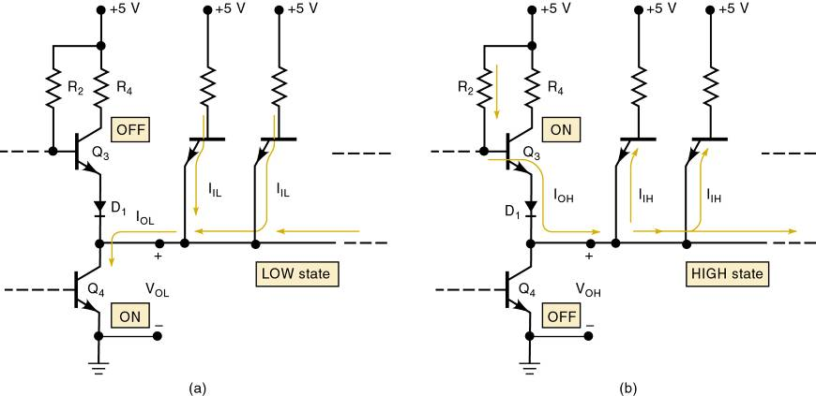
8-5 TTL Loading and Fan Out
Currents when a TTL output is driving several inputs.
Digital Systems: Principles and Applications, 11/e
Ronald J. Tocci, Neal S. Widmer, Gregory L. Moss

Slide 39
8-6 Other TTL Characteristics
Unconnected (floating) inputs.
On any TTL IC, all of the inputs are 1s if they are not connected to some logic signal.
An input left unconnected, it is said to be floating.
Digital Systems: Principles and Applications, 11/e
Ronald J. Tocci, Neal S. Widmer, Gregory L. Moss

Slide 40
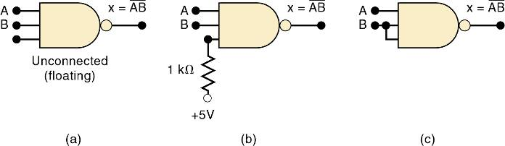
8-6 Other TTL Characteristics – Unused Inputs
Frequently, not all inputs on a TTL IC are being used in a particular application.
A common example is when not all the inputs to a logic gate are needed for the required logic function.
Unused input can be connected to +5V through a 1k-Ohm resistor, so the logic level is a 1.
A third possibility is where the unused input is tied to a used input.
Three ways to handle unused logic inputs.
Digital Systems: Principles and Applications, 11/e
Ronald J. Tocci, Neal S. Widmer, Gregory L. Moss

Slide 41
8-6 Other TTL Characteristics – Tied-Together Inputs
Two (or more) TTL inputs on the same gate connected to form a common input will generally represent a load that is the sum of the load current rating of each individual input.
The only exception is for NAND and AND gates.
The LOW-state input load will be the same as a single input—no matter how many inputs are tied together.
Digital Systems: Principles and Applications, 11/e
Ronald J. Tocci, Neal S. Widmer, Gregory L. Moss

Slide 42
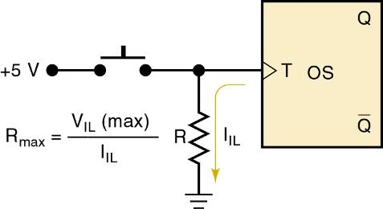
8-6 Other TTL Characteristics – Biasing TTL Inputs LOW
Occasionally a TTL input must be held normally LOW and caused to go HIGH by actuation of a mechanical switch.
The one-shot triggers on a positive transition that occurs when the switch is momentarily closed.
Resistor R keeps the T input LOW while the switch is open.
Digital Systems: Principles and Applications, 11/e
Ronald J. Tocci, Neal S. Widmer, Gregory L. Moss

Slide 43
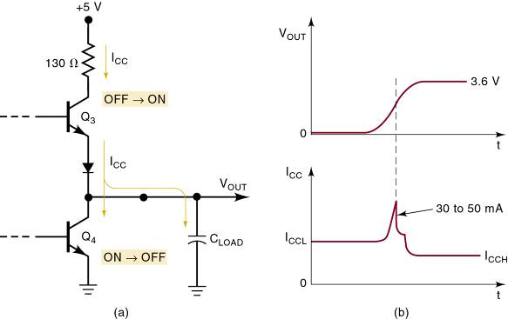
8-6 Other TTL Characteristics – Current Transients
TTL logic circuits suffer from internally generated current transients or spikes due to the totem-pole output structure.
Ceramic disk capacitors (.01 or .1 μF) are used to short these high frequency spikes to ground.

Slide 44
Reference:
Digital Systems: Principles and Applications, 11/e Ronald J. Tocci, Neal S. Widmer, Gregory L. Moss
Digital Systems: Principles and Applications, 11/e
Ronald J. Tocci, Neal S. Widmer, Gregory L. Moss

